Slide 1
2021-22 fafsa.gov preview presentation
September 2020
Notes:
2021-22 title slide.

Slide 2
TOPICS
Overview
Home view
Login view
Dependent Student with Parental Data view
Independent Student view
My FAFSA views
SAR view
FAFSA® Corrections view
Auto-Zero EFC (skipping the remaining financial questions) view
Special Circumstances view
Special Circumstance – Unsubsidized Loan Only view
Homeless Circumstance view
Additional Resources view
Additional Resources
Notes:
2021-22 Topics slide.

Slide 3
OVERVIEW
The 2021-22 fafsa.gov preview presentation provides screenshots that financial aid professionals, mentors, and counselors can use as a guide for the 2021-22 fafsa.gov application. The screenshots and information provided can be used to create/modify presentations for professional trainings and high school nights.
The screenshots are intended to show the majority of the questions displayed in fafsa.gov; however, most applicants and/or parents are unlikely to need to answer all of the questions when completing their application.
The screenshots used in this presentation shows examples of what fafsa.gov will look like.
Notes:
2021-22 Overview slide.

Slide 4
OVERVIEW (CONTINUED, PART 1)
The 2021-22 version of fafsa.gov will be available for applicants to use on October 1, 2020.
The 2021-22 fafsa.gov web demonstration site will be available on September 27, 2020.
Notes:
2021-22 Overview slide continued part 1.

Slide 5
OVERVIEW (CONTINUED, PART 2)
The following are key features of fafsa.gov:
Students and parents may begin, complete, and submit a new or renewal FAFSA form for the 2021–22 FAFSA® form processing cycle.
Students and parents who are eligible may use the IRS Data Retrieval Tool (IRS DRT) to electronically transfer federal tax return information into a FAFSA form.
Students and parents may be eligible to transfer their FAFSA information into their state aid application. Participating states include Iowa, Minnesota, Mississippi, New Jersey, New York, Pennsylvania, and Vermont.
Parents that have multiple students who need to file an application may be eligible to transfer their FAFSA information into a new application from the original student’s confirmation page.
Students will be able to view additional information about the schools they selected on their FAFSA form for easy comparison of schools.
Students and parents have the ability to correct or update an application once it’s been processed.
Students and parents can save an application from fafsa.gov and resume where they left off on the mobile app and vice versa.
Notes:
2021-22 Overview slide continued part 2.

Slide 6
Home view
Notes:
2021-22 Home title slide.

Slide 7
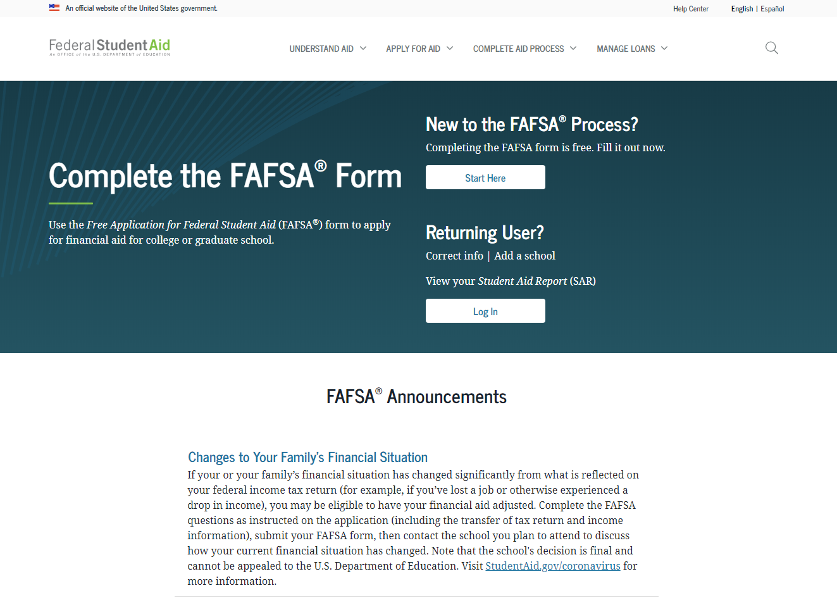
Notes:
2021-22 fafsa.gov home view.
The fafsa.gov home view features a two-button login option and current announcements, as well as an easy-access tool bar, featuring links to applying for aid and loan information.

Slide 8
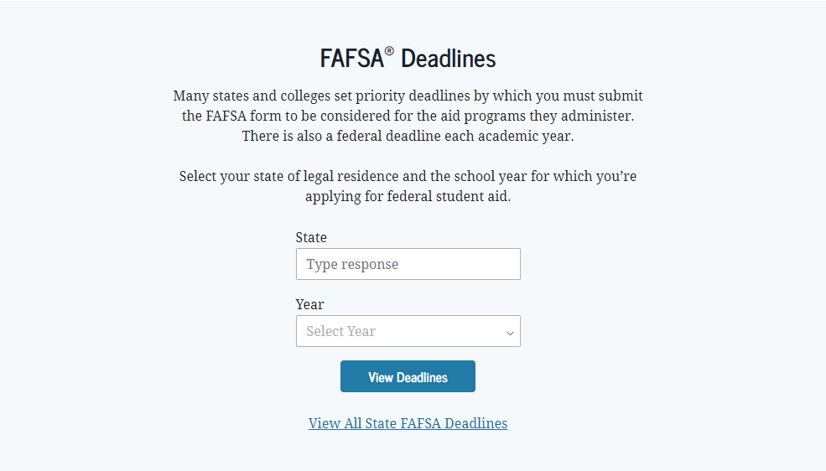
Notes:
2021-22 fafsa.gov home view continued.
The fafsa.gov home view features a link to the student aid deadline search function that is available by state and cycle year.

Slide 9
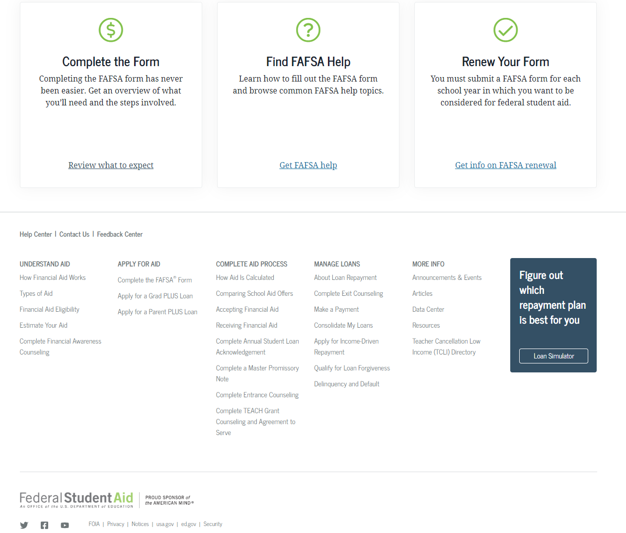
Notes:
2021-22 fafsa.gov home view continued-2.
The fafsa.gov home view features three links to help users navigate the financial aid process including completing the form, FAFSA help view, and information on FAFSA renewal.
Additional Studentaid.gov links are also provided at the bottom of the homepage.

Slide 10
Login
Notes:
Login title slide.

Slide 11
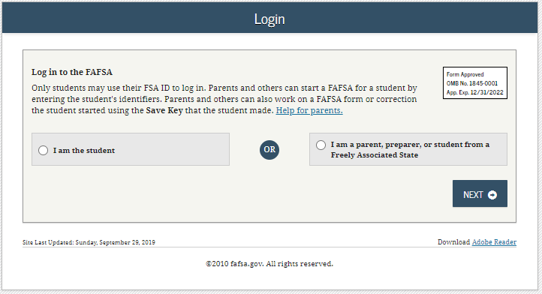
Notes:
2021-22 “Login” view.

Slide 12
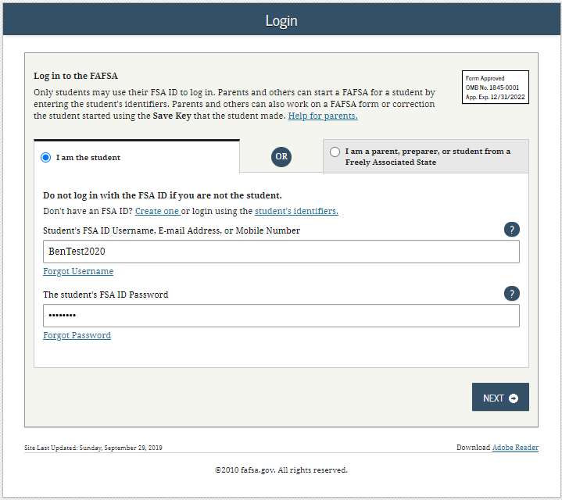
LOGIN – I AM THE STUDENT
Notes:
2021-22 “Login” view with the “I am the student” option selected.
Note: If using this option, the applicant can choose one of three ways to log in to the application: using an FSA ID, a verified email address, or a verified phone number.

Slide 13
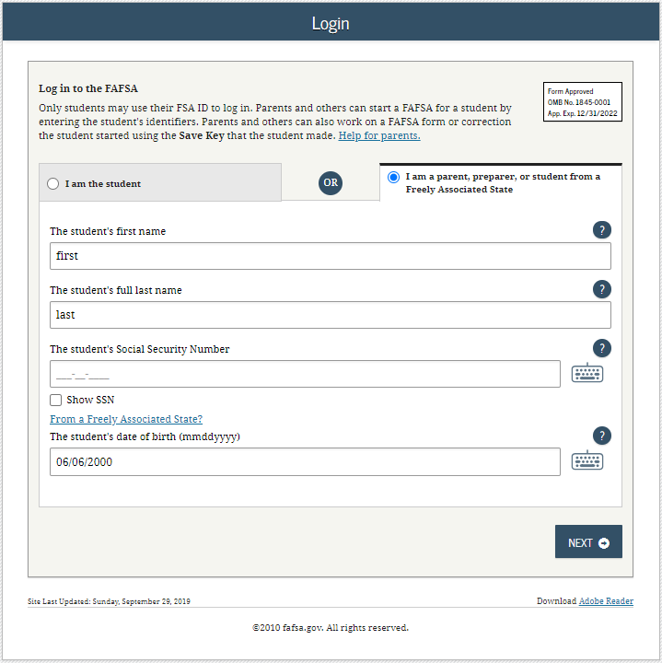
Notes:
2021-22 “Login” view with the “I am a parent, preparer, or student from a Freely Associated State” option selected.
The SSN is masked by default and users have the ability to check the “Show SSN” box if they wish to see what is being typed in.

Slide 14
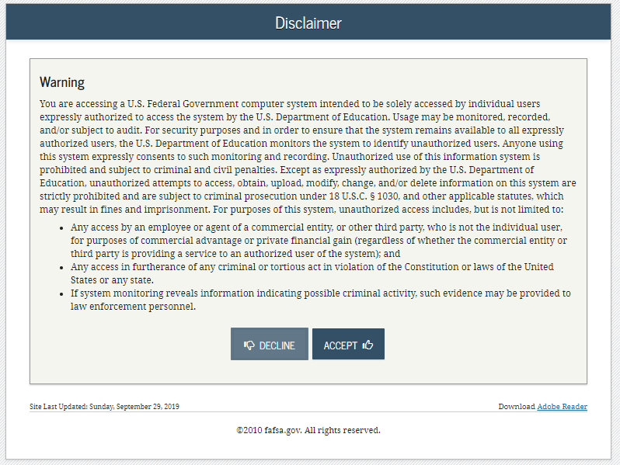
Notes:
2021-22 “Disclaimer” view.

Slide 15
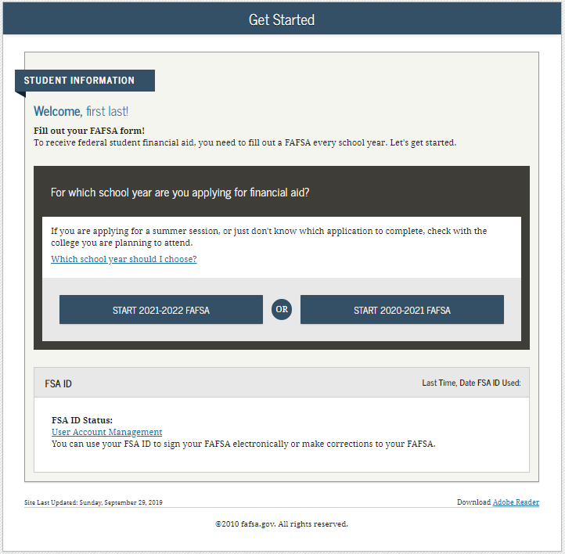
Notes:
2021-22 “Get Started” view.

Slide 16
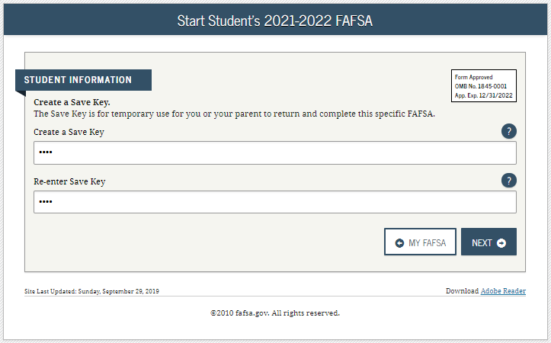
Notes:
2021-22 “Create a Save Key” view.
The Save Key allows an applicant to save their Free Application for Federal Student Aid (FAFSA®) form and return at a later time to complete and submit the application. The application is saved for 45 days, unless the applicant submits their application for processing prior to that. Additionally, the Save Key provides applicants a way to share access to their FAFSA form or correction if their parent(s) needs to add information or sign it.

Slide 17
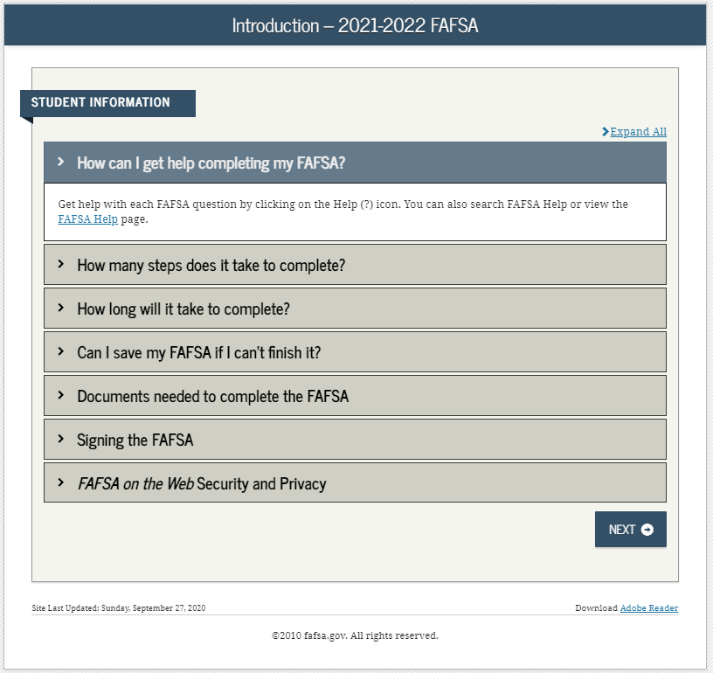
Notes:
2021-22 “Introduction” view.
Each topic has accordion functionality that can be expanded and contracted to reveal or conceal additional information.

Slide 18
Dependent Student with Parental Data
Notes:
Dependent Student with Parental Data title slide – logged in as an applicant.

Slide 19
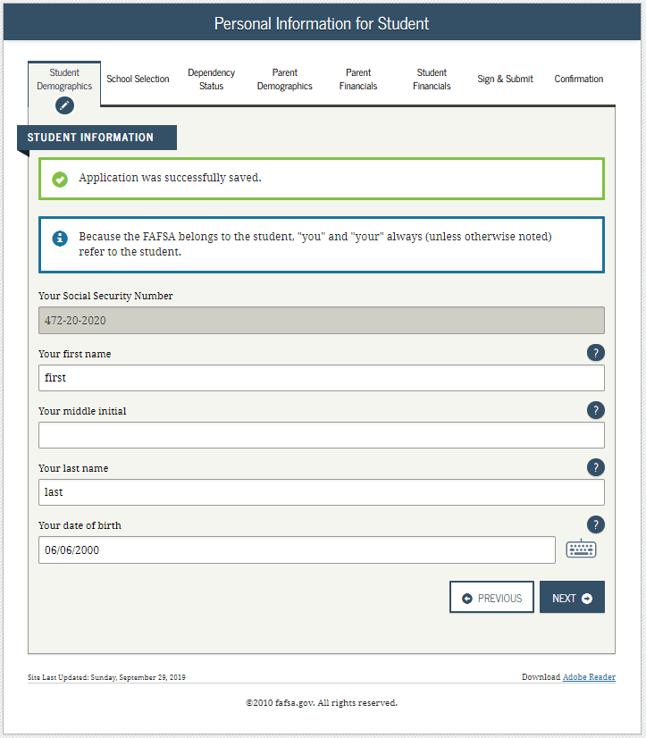
Notes:
2021-22 “Personal Information for Student” view.
This is one of multiple pages on fafsa.gov that explains that “you” and “your” are referencing the applicant. Other pages where this messaging appears includes the Search for High School, Student Marital Status, Parent Marital Status, and Student Tax Filing Status.
The box highlighted in green indicates that the application has been successfully saved.
Note: This is the first view for the Student Demographics section.

Slide 20
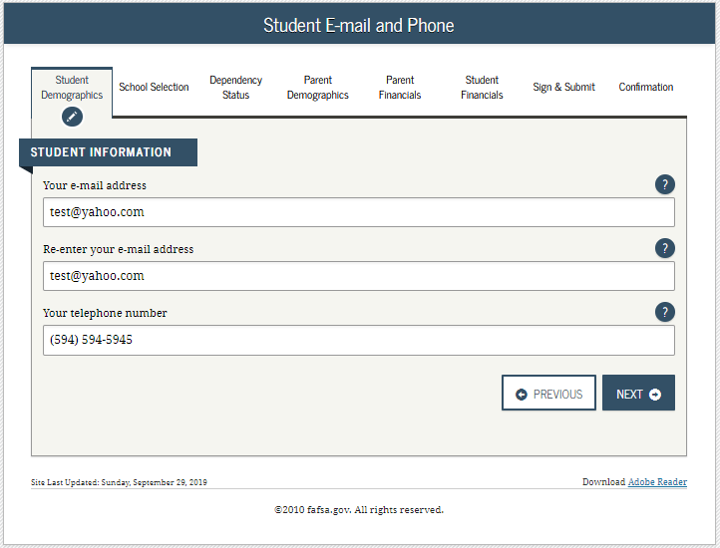
Notes:
2021-22 “Student E-mail and Phone” view.
Note: While not mandatory, it is beneficial for the applicant/parent to include an e-mail address on the FAFSA form in order to receive important communications about their financial aid.

Slide 21
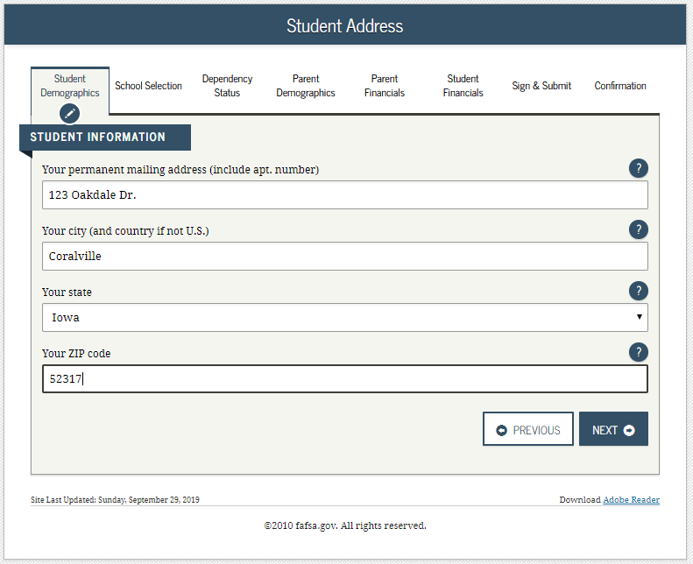
Notes:
2021-22 “Student Address” view.

Slide 22
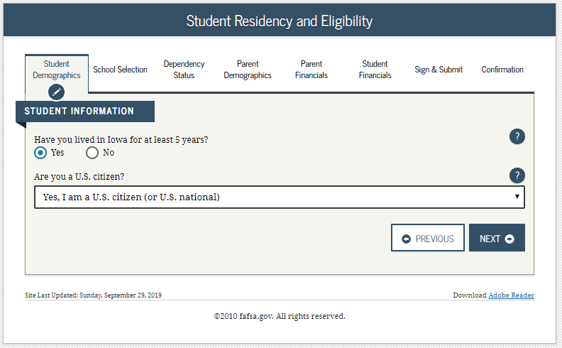
Notes:
2021-22 “Student Residency and Eligibility” view.

Slide 23
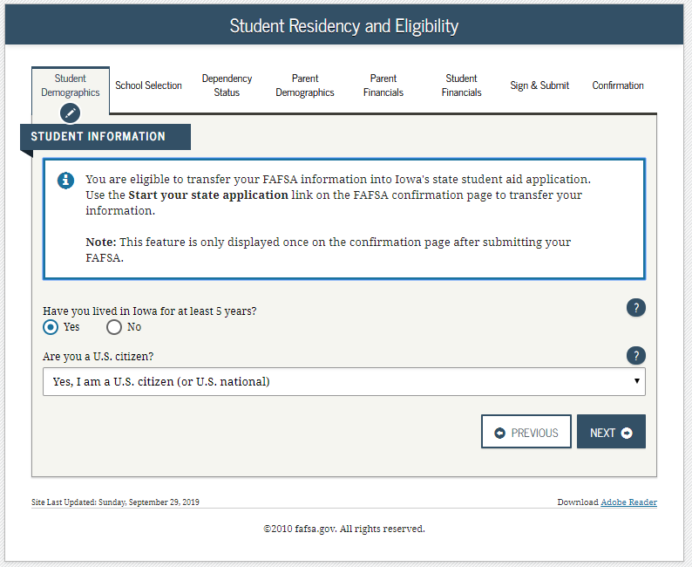
Notes:
2021-22 “Student Residency and Eligibility” view continued.
The informational message displays to notify the applicant that they are eligible to transfer their FAFSA information to their participating state aid application. The link will be available on the FAFSA confirmation page. This message will only display when the applicant indicates a participating state as their state of legal residence.
Participating states include: Iowa, Minnesota, Mississippi, New York, New Jersey, Pennsylvania, and Vermont.

Slide 24
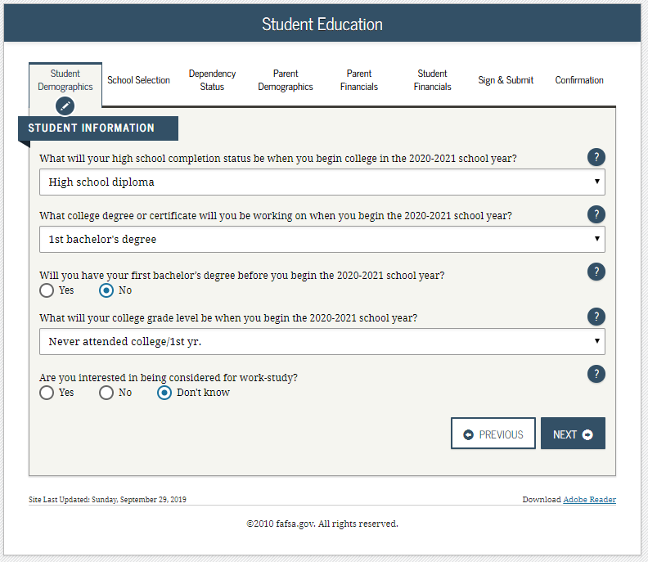
Notes:
2021-22 “Student Education” view.

Slide 25
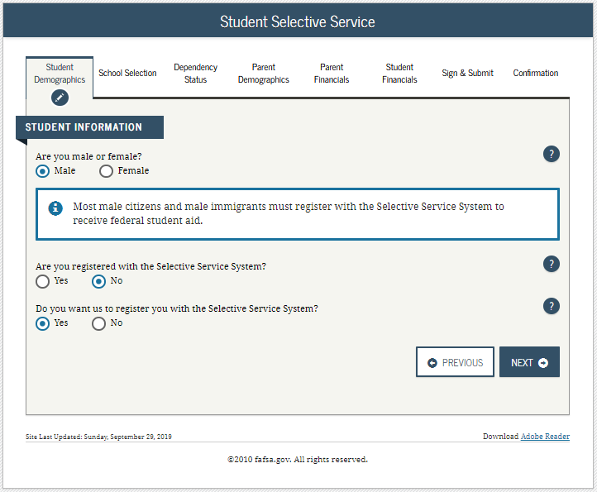
Notes:
2021-22 “Student Selective Service” view.
Note: The response to this question is used to determine if the applicant needs to register with the Selective Service System (SSS). Most male citizens and male immigrants between the ages of 18–25 must register with the SSS to receive federal student aid. This requirement applies to any person assigned the sex of male at birth.

Slide 26
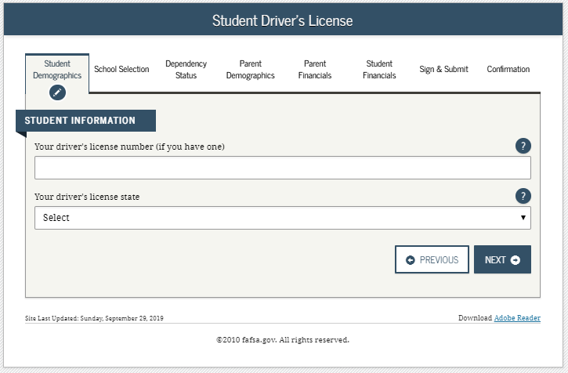
Notes:
2021-22 “Student Driver’s License” view.

Slide 27
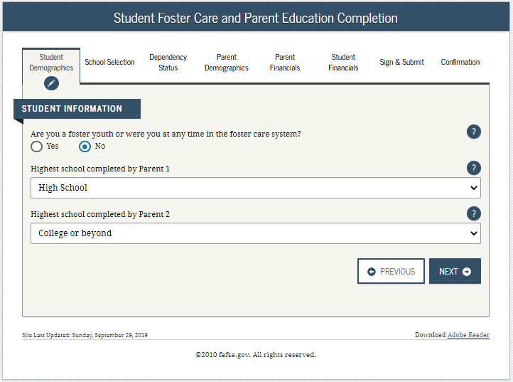
Notes:
2021-22 “Student Foster Care and Parent Education Completion” view.

Slide 28
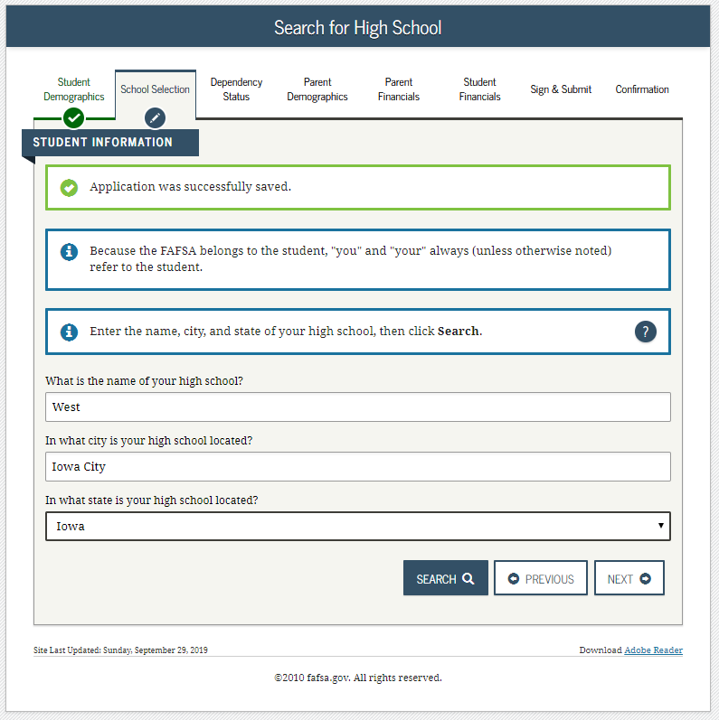
Notes:
2021-22 “Search for High School” view.
Note: This is the first page for the School Selection section.

Slide 29
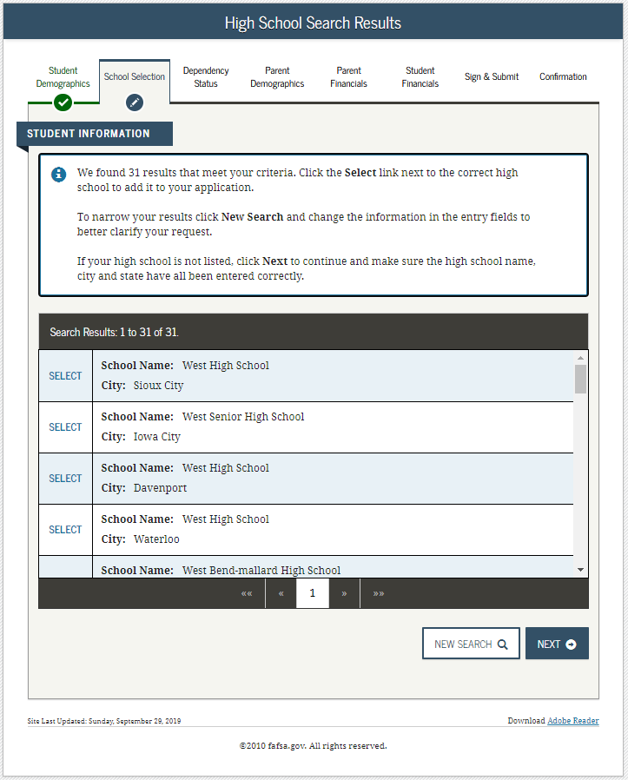
Notes:
2021-22 “High School Search Results” view.

Slide 30
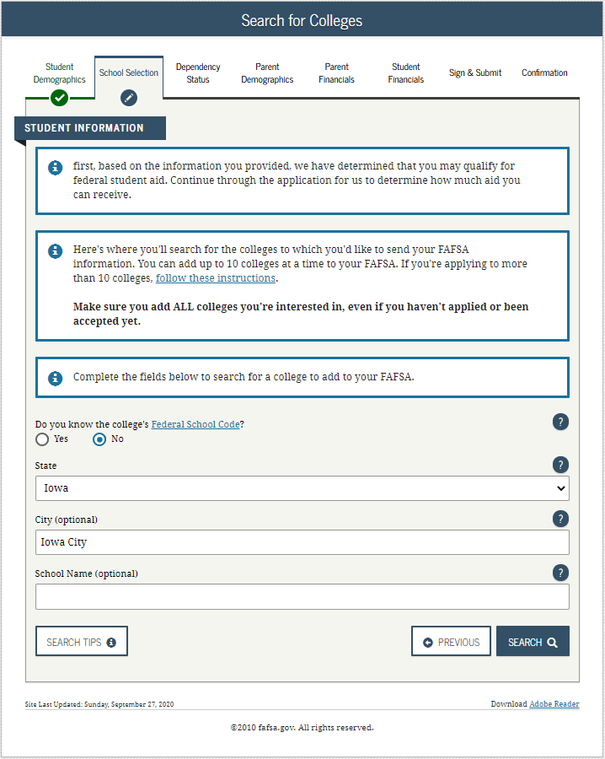
Notes:
2021-22 “Search for Colleges” view.

Slide 31
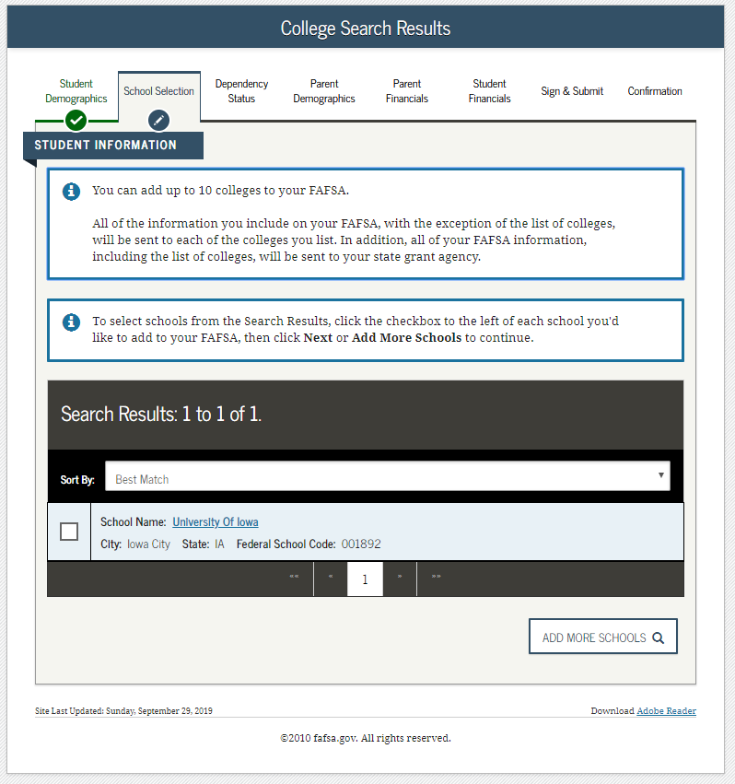
Notes:
2021-22 “College Search Results” view.

Slide 32
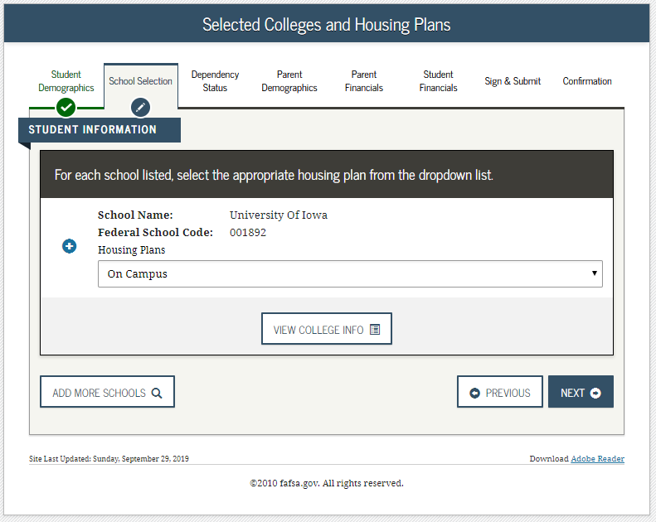
Notes:
2021-22 “Selected Colleges and Housing Plans” view.

Slide 33
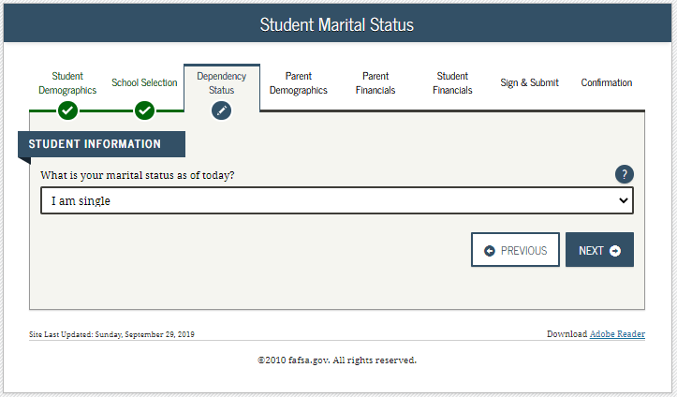
Notes:
2021-22 “Student Marital Status” view.
Note: This is the first page of the Dependency Status section.

Slide 34
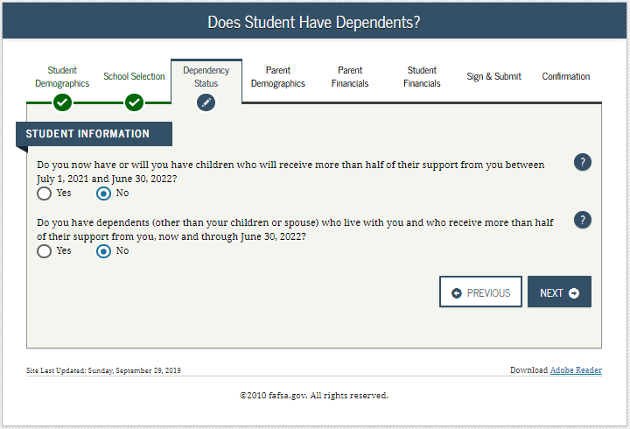
Notes:
2021-22 “Does Student Have Dependents?” view.

Slide 35
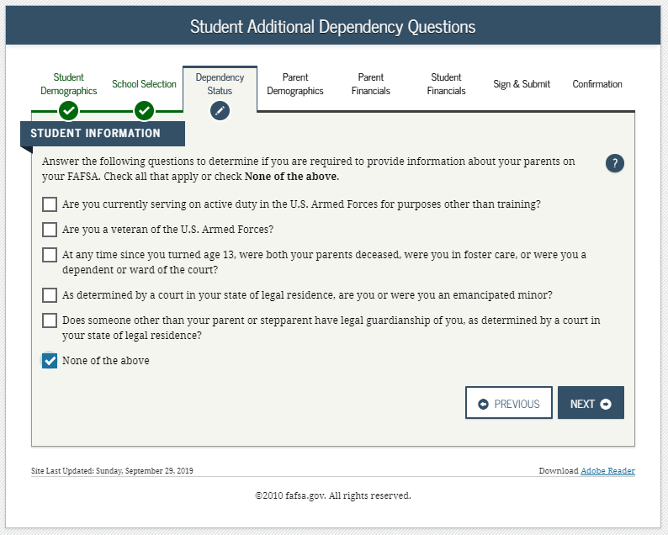
Notes:
2021-22 “Student Additional Dependency Questions” view.

Slide 36
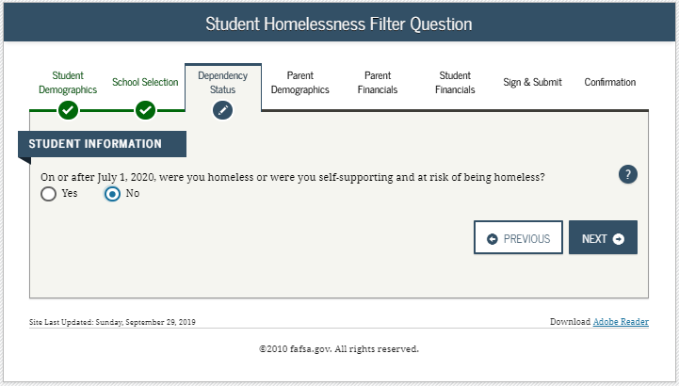
Notes:
2021-22 “Student Homelessness Filter Question” view.

Slide 37
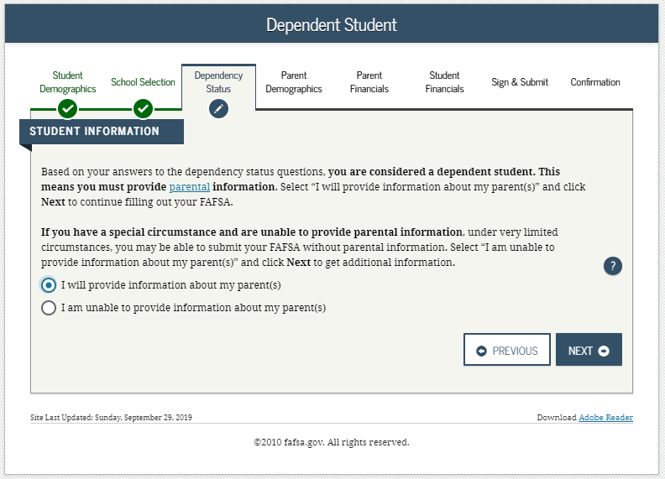
Notes:
2021-22 “Dependent Student” view.
This page only displays if it has been determined that the applicant is considered to be dependent.

Slide 38
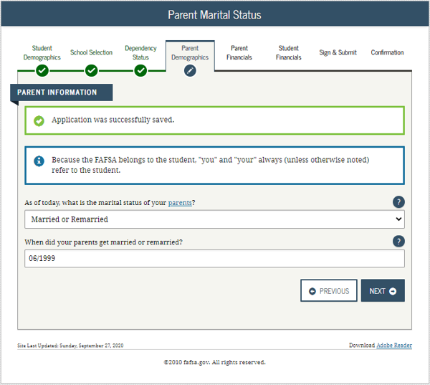
Notes:
2021-22 “Parent Marital Status” view.
Note: This is the first view in the Parent Demographics section.

Slide 39
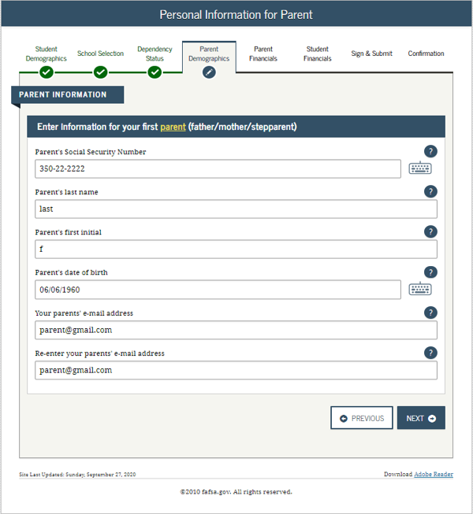
Notes:
2021-22 “Personal Information for Parent” view.

Slide 40
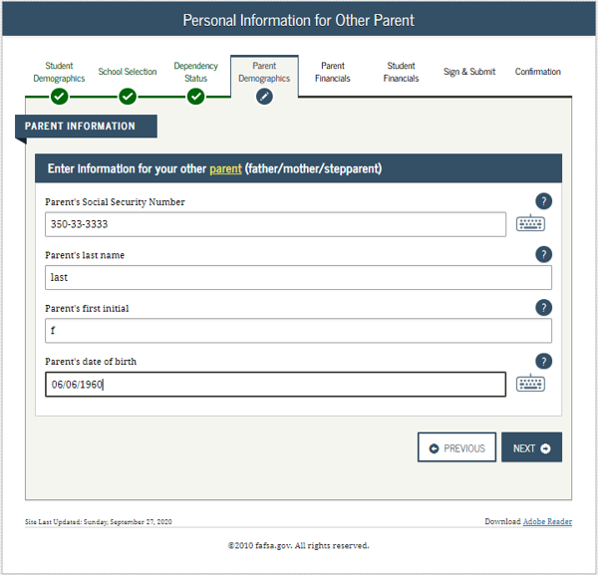
Notes:
2021-22 “Personal Information for Other Parent” view.

Slide 41
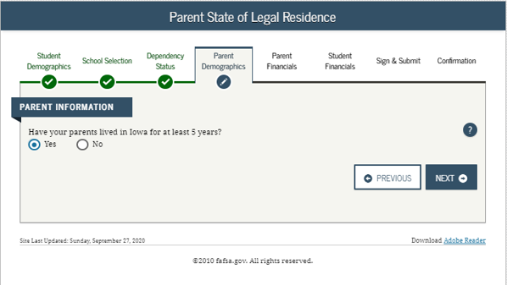
Notes:
2021-22 “Parent State of Legal Residence” view.

Slide 42
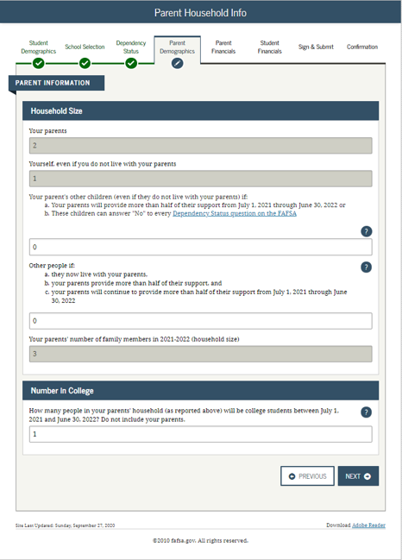
Notes:
2021-22 “Parent Household Info” view.
Parents are required to complete the household size worksheet in an effort to get more accurate information about the number in the parent’s household and the number of those in the household who are in college. Some information will be prefilled, based on responses provided previously within the FAFSA form. The system tallies the totals as the parent completes the worksheet to ensure that there are no mathematical errors.

Slide 43
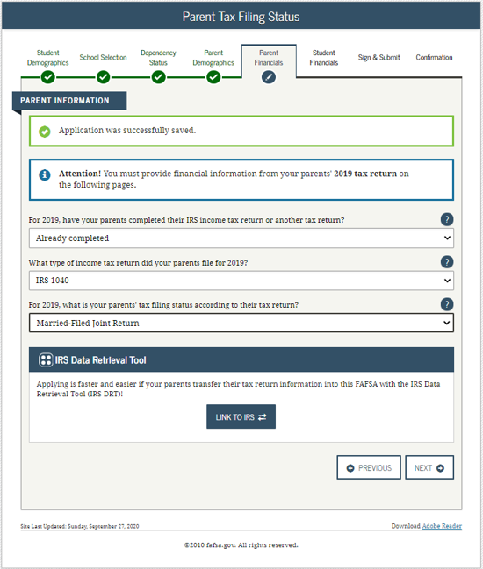
Notes:
2021-22 “Parent Tax Filing Status” view.
Note: This is the first view in the Parent Financials section.

Slide 44
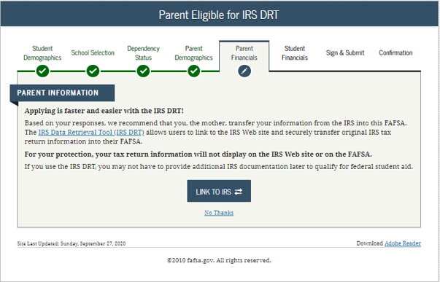
Notes:
2021-22 “Parent Eligible for IRS DRT” view.
This view is displayed when the parent chooses not to use the IRS Data Retrieval Tool (DRT) on the previous view. An additional opportunity is presented to the parent to determine if they would like to link to the IRS for their financial information or to continue to enter it manually.

Slide 45
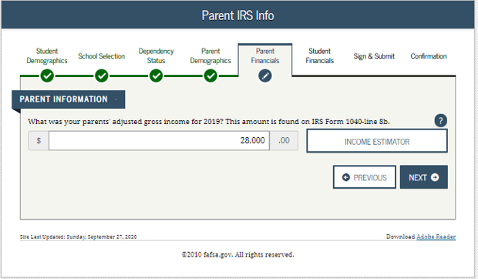
Notes:
2021-22 “Parent IRS Info” view.
Note: If the parent is either ineligible or decides not to use the IRS DRT, they will be required to enter their financial information manually.

Slide 46
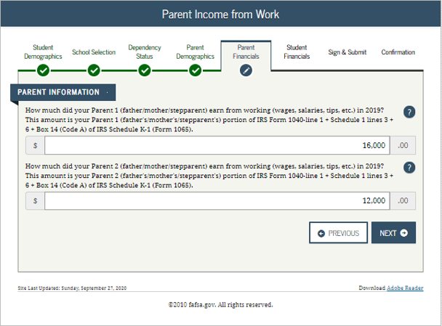
Notes:
2021-22 “Parent Income from Work” view.

Slide 47
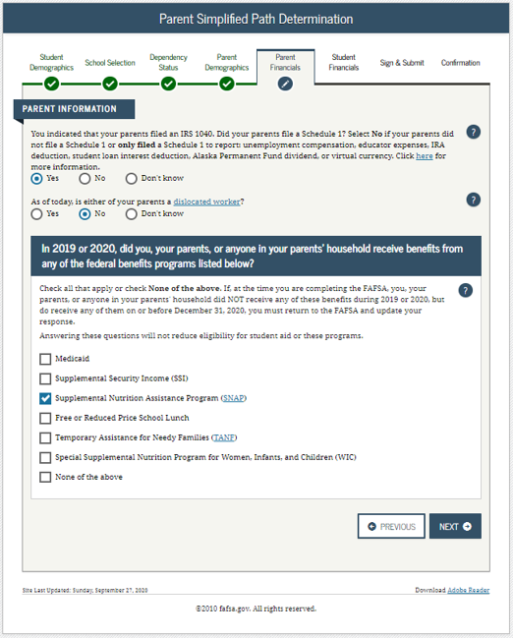
Notes:
2021-22 “Parent Simplified Path Determination” view.
Instructional text will be dynamic based on the response to Parent Tax Return Status. In this example, the parent stated they “already filed” and “filed a 1040” in order to create the condition for schedule 1 dynamic text to display.
Note: The Schedule 1 question and associated help text have been updated to include all of the exceptions to answering this question. For the 21-22 cycle, capital gains and losses have been removed from the list of exceptions; reporting of virtual currency has been added.
In addition, the Schedule 1 question is now a field that can be transferred from the IRS DRT.
The Schedule 1 question may or may not be enabled based on previously answered questions.

Slide 48
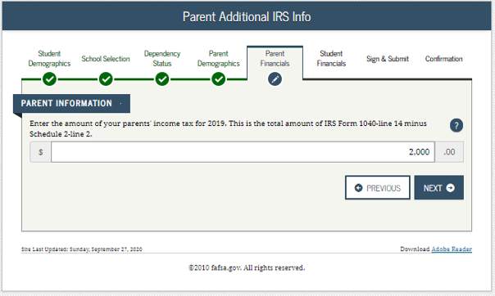
Notes:
2021-22 “Parent Additional IRS Info” view.

Slide 49
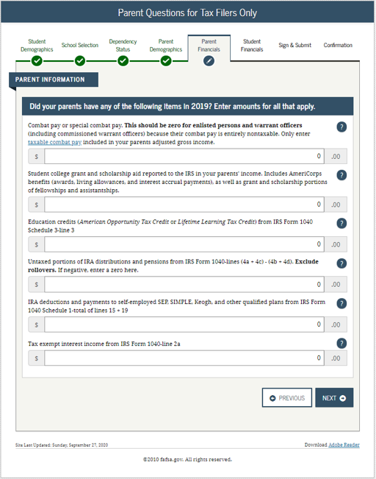
Notes:
2021-22 “Parent Questions for Tax Filers Only” view.

Slide 50
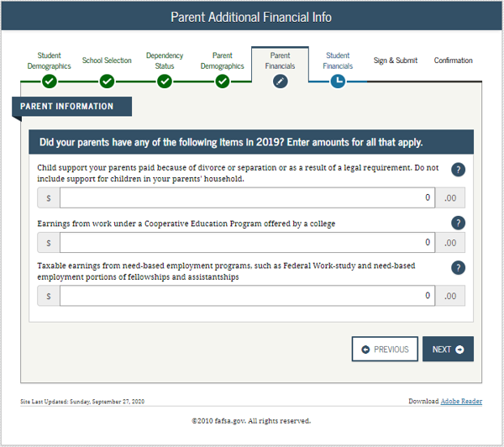
Notes:
2021-22 “Parent Additional Financial Info” view.

Slide 51
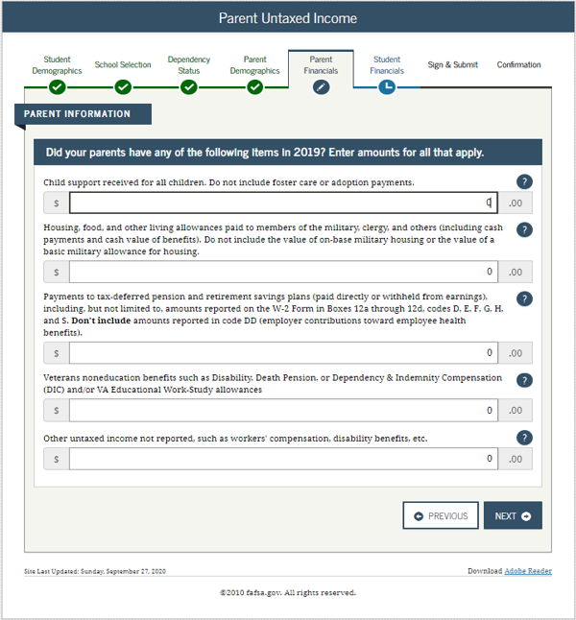
Notes:
2021-22 “Parent Untaxed Income” view.

Slide 52
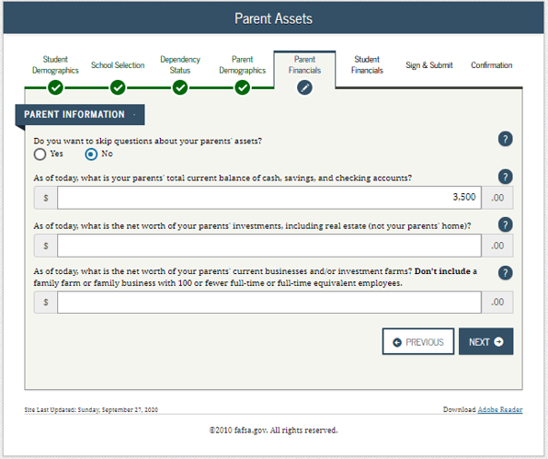
Notes:
2021-22 “Parent Assets” view.
Note: Since the parents meet the simplified needs path determination criteria, the assets questions are optional.

Slide 53
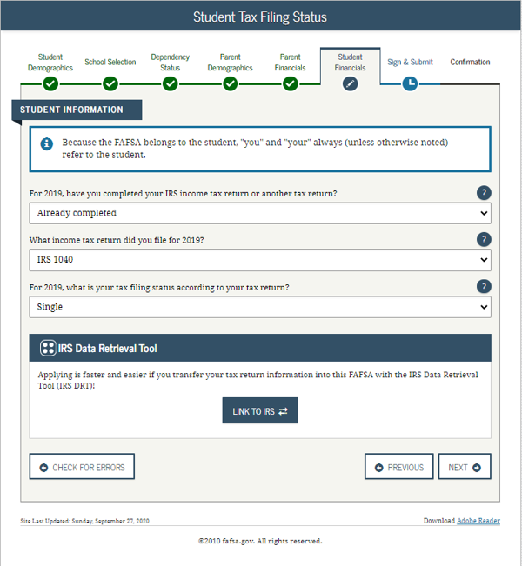
Notes:
2021-22 “Student Tax Filing Status” view.

Slide 54
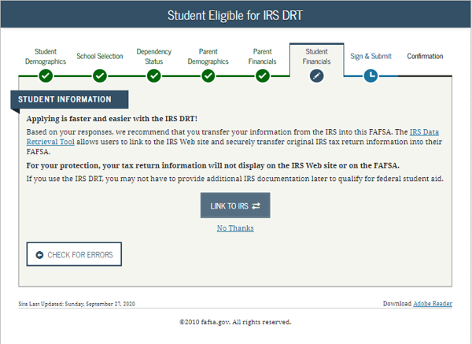
Notes:
2021-22 “Student Eligible for IRS DRT” view.
This view is displayed when the applicant chooses not to use the IRS Data Retrieval Tool (DRT) on the previous view. An additional opportunity is presented to the applicant to determine if they would like to link to the IRS for their financial information or to continue to enter it manually.

Slide 55
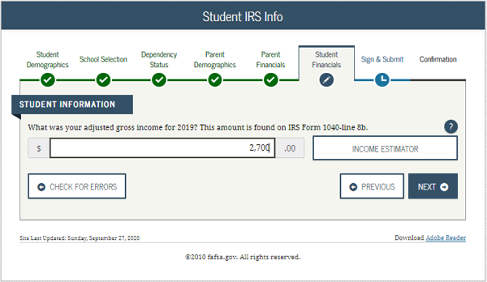
Notes:
2021-22 “Student IRS Info” view.
Note: If the applicant is either ineligible or decides not to use the IRS DRT, they will be required to enter their financial information manually.

Slide 56
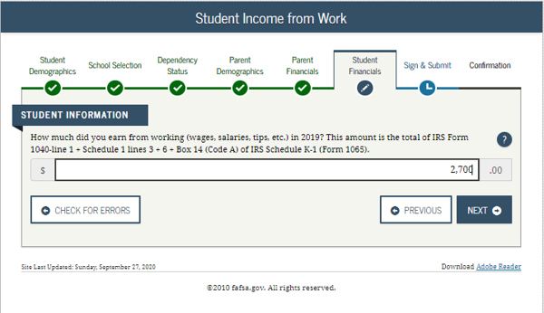
Notes:
2021-22 “Student Income from Work” view.

Slide 57
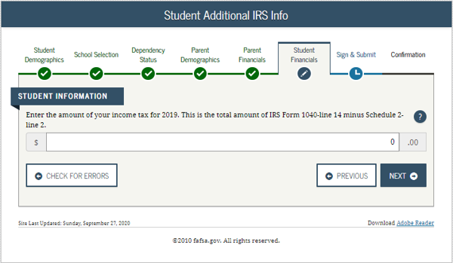
Notes:
2021-22 “Student Additional IRS Info” view.

Slide 58
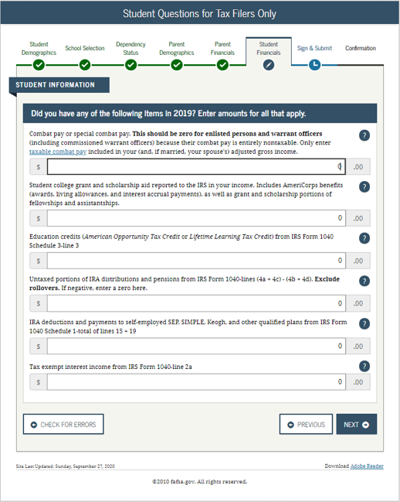
Notes:
2021-22 “Student Questions for Tax Filers Only” view.

Slide 59
Notes:
2021-22 “Student Additional Financial Info” view.

Slide 60
Notes:
2021-22 “Student Untaxed Income” view.

Slide 61
Notes:
2021-22 “Student Assets” view.

Slide 62
Notes:
2021-22 “Preparer Info” view.

Slide 63
Notes:
2021-22 “FAFSA Summary” view – Student Demographics and School Selection.

Slide 64
Notes:
2021-22 “FAFSA Summary” view continued – Dependency Status, Parent Demographics and Parent Financials.

Slide 65
Notes:
2021-22 “FAFSA Summary” view continued– Parent Financials Continued, Student Financials, Sign & Submit.

Slide 66
Notes:
2021-22 “Signature Status” view.

Slide 67
Notes:
2021-22 “Agreement of Terms” student view.
This is where the applicant acknowledges the Certification Statement.

Slide 68
Notes:
2021-22 “Signature Options” view for applicant.

Slide 69
Notes:
2021-22 “Signature Status” view.
Applicant signature accepted, and now the parent will need to sign.

Slide 70
Notes:
2021-22 “Which Parent Signs” view.
Allows the user to select which parent will be signing the application.
The choice between parents is only present if information was provided for two parents. Otherwise, this view does not display.

Slide 71
Notes:
2021-22 “Agreement of Terms” view for parent.
This is where the parent acknowledges the Certification Statement.

Slide 72
Notes:
2021-22 “Signature Options” view for parent.
Parent FSA ID and password will not be required if the parent used the IRS DRT.

Slide 73
Notes:
2021-22 “Signature Options” view for parent continued.
The parent of the applicant has the option to choose between three different ways of signing the application: Sign Electronically With My FSA ID, Print A Signature Page, or Submit Without Signatures. In this scenario the parent chose to sign the FAFSA form electronically.

Slide 74
Notes:
2021-22 “Signature Status” view.
Shows both applicant and parent signatures have been accepted.

Slide 75
Notes:
2021-22 “Confirmation Page” view.
Some states provide the option to transfer part of the applicant’s FAFSA information into a state aid application.
Parents of applicants are offered the option to transfer the parents’ data into another applicant's new FAFSA form by clicking the blue box saying “Does your brother or sister need to complete a FAFSA?”
If the applicant leaves the confirmation view before they click this link, they will not be able to return to transfer data to the application of a sibling.

Slide 76
Independent Student
Notes:
Independent Student title slide.

Slide 77
Notes:
2021-22 “Login” view.

Slide 78
Notes:
2021-22 “Disclaimer” view.

Slide 79
Notes:
2021-22 “Get Started” view.
The applicant can view the status of their FSA ID in the FSA ID section of the “Get Started” view.

Slide 80
Notes:
2021-22 “Create a Save Key” view.
The Save Key allows an applicant to save their FAFSA form and return at a later time to complete and submit the application. The application is saved for 45 days, unless the applicant submits their application for processing prior to that. Additionally, the Save Key provides applicants a way to share access to their FAFSA form or correction if their parent(s) needs to add information or sign it.

Slide 81
Notes:
2021-22 “Introduction” view.
Each topic has accordion functionality that can be expanded and contracted to reveal or conceal additional information.

Slide 82
Notes:
2021-22 “Personal Information for Student” view.
This is one of multiple views on fafsa.gov that explains that “you” and “your” are referencing the applicant. Other views where this messaging appears include the Search for High School, Student Marital Status, Parent Marital Status, and Student Tax Filing Status.
The additional box highlighted in green indicates that the application has been successfully saved.
Note: This is the first view of the Student Demographics section.

Slide 83
Notes:
2021-22 “Student E-mail and Phone” view.
Note: While not mandatory, it is beneficial for the applicant to include an e-mail address on the FAFSA form in order to receive important communications about their financial aid.

Slide 84
Notes:
2021-22 “Student Address” view.

Slide 85
Notes:
2021-22 “Student Residency and Eligibility” view.
The informational message displays to notify the applicant that they are eligible to transfer their FAFSA information to their participating state aid application. The link will be available on the FAFSA confirmation page. This message will only display when the applicant indicates a participating state as their state of legal residence.
Participating states include: Iowa, Minnesota, Mississippi, New York, New Jersey, Pennsylvania, and Vermont.

Slide 86
Notes:
2021-22 “Student Education” view.

Slide 87
Notes:
2021-22 “Student Selective Service” view.
Note: The response to this question is used to determine if the applicant needs to register with the Selective Service System (SSS). Most male citizens and male immigrants between the ages of 18–25 must register with the SSS to receive federal student aid. This requirement applies to any person assigned the sex of male at birth.

Slide 88
Notes:
2021-22 “Student Driver’s License” view.

Slide 89
Notes:
2021-22 “Student Foster Care and Parent Education Completion” view.

Slide 90
Notes:
2021-22 “Search for High School” view.
Note: This is the first view of the School Selection section.

Slide 91
Notes:
2021-22 “Search for High School Results” view.

Slide 92
Notes:
2021-22 “Search for Colleges” view.

Slide 93
Notes:
2021-22 “College Search Results” view.

Slide 94
Notes:
2021-22 “Selected Colleges and Housing Plans” view.

Slide 95
Notes:
2021-22 “Student Marital Status” view.
Note: This is the first view of the Dependency Status section.

Slide 96
Notes:
2021-22 “Does Student Have Dependents?” view.

Slide 97
Notes:
2021-22 “Student Household Info” view.
Applicants are required to complete the household size worksheet in an effort to get more accurate information about the number in the applicant’s household and the number of those in the household who are in college. Some information will be prefilled, based on responses provided previously within the FAFSA form. The system tallies the totals as the applicant completes the worksheet to ensure that there are no mathematical errors.

Slide 98
Notes:
2021-22 “Independent Student” view.
This view only displays if it has been determined that the applicant is considered to be independent. Generally independent applicants have the choice of whether or not to answer questions about their parents; however, some health professions or law schools may require parent information.

Slide 99
Notes:
2021-22 “Student Tax Filing Status” view.
Note: This is the first view of Student Financials section.
Parent Demographics and Financials have been skipped because the applicant is independent and chose to skip them.

Slide 100
Notes:
2021-22 “Leaving the fafsa.gov pop-up” view.
Note: This pop-up window displays when the applicant chooses to use the IRS DRT on the previous page.

Slide 101
Notes:
2021-22 “IRS Website Disclaimer” view.

Slide 102
Notes:
2021-22 “Get My Federal Income Tax Information” view.
Note: This is where the applicant provides tax information exactly as it appears on their tax return. Some information will be pre-filled from the FAFSA form such as name, SSN, date of birth, and tax filing status.

Slide 103
Coralville
Notes:
2021-22 “Get My Federal Income Tax Information” view - continued.

Slide 104
Notes:
2021-22 “Federal Income Tax Information Results” view.
Note: This page gives the user the opportunity to check the box and then transfer their federal tax information into the FAFSA form.

Slide 105
Notes:
2021-22 “Student IRS Info” view.
Note: In this scenario, the applicant chose to transfer financial information via the IRS DRT.

Slide 106
Notes:
2021-22 “Student Income from Work” view.

Slide 107
Notes:
2021-22 “Student Additional IRS Info” view.

Slide 108
Notes:
2021-22 “Student Simplified Path Determination” view.
Note: The Schedule 1 question and associated help text have been updated to include all of the exceptions to answering this question. For the 21-22 cycle, capital gains and losses have been removed from the list of exceptions; reporting of virtual currency has been added.
In addition, the Schedule 1 question is now a field that can be transferred from the IRS DRT.
The Schedule 1 question may or may not be enabled based on previously answered questions.

Slide 109
Notes:
2021-22 “Student Questions for Tax Filers Only” view.

Slide 110
Notes:
2021-22 “Student Additional Financial Info” view.

Slide 111
Notes:
2021-22 “Student Untaxed Income” view.

Slide 112
Notes:
2021-22 “Student Assets” view.

Slide 113
Notes:
2021-22 “Preparer Info” view.
Note: This is the first view of Sign & Submit.

Slide 114
Notes:
2021-22 “FAFSA Summary” view for independent applicant– Student Demographics and School Selection.

Slide 115
Notes:
2021-22 “FAFSA Summary” view for independent applicant continued – Dependency Status and Student Financials.

Slide 116
Notes:
2021-22 “FAFSA Summary” view for independent applicant continued – Sign & Submit.

Slide 117
Notes:
2021-22 “Agreement of Terms” view.

Slide 118
Notes:
2021-22 “Signature Options” view.

Slide 119
Notes:
2021-22 “Signature Status” view.

Slide 120
Notes:
2021-22 “Confirmation Page” view.

Slide 121
My FAFSA views
Notes:
My FAFSA title slide.

Slide 122
MY FAFSA VIEW
The My FAFSA view is a navigation tool for the applicant when accessing the fafsa.gov site.
The view provides the following dynamic options and messaging based on the Student’s FAFSA form status:
Start a 2021-2022 FAFSA form
Complete and submit a FAFSA Renewal
Action Required
Continue or Start Over
Application Processed Successfully
Make FAFSA Corrections
View the Student Aid Report (SAR)
View Corrections History
Create a shareable file with some of your student information using MyStudentData Download
Provide Missing Signatures
User Account Management
Notes:
My FAFSA view(s) appear when an applicant or parent logs into the fafsa.gov website and a transaction is on file.
This view is not to be mistaken with the separate myStudentAid application.

Slide 123
Notes:
2021-22 “Get Started” view.
If a transaction is not found when the user logs in, they will be presented with the 2021-22 “Get Started” view.

Slide 124
Notes:
2021-22 “My FAFSA” renewal view.
A FAFSA renewal exists when the applicant has a FAFSA form with a valid EFC from the previous year. Selecting “FAFSA Renewal” allows the applicant to prefill the current year’s FAFSA form with some data from last year’s application.

Slide 125
Notes:
2021-22 “My FAFSA” view where further action is required.
This view displays when the applicant has an error (excluding missing signatures).

Slide 126
Notes:
2021-22 “My FAFSA” view where the applicant can choose to continue their application or start over.
This view displays when the applicant has started an application, but exited out before submitting.

Slide 127
Notes:
2021-22 “My FAFSA” view where the applicant has a processed application.

Slide 128
FAFSA® Corrections
Notes:
Make FAFSA Corrections title slide.

Slide 129
Notes:
2021-22 “My FAFSA” view where the user can make corrections.

Slide 130
Notes:
2021-22 “Make Corrections” view for save key creation.

Slide 131
Notes:
2021-22 “Leaving the fafsa.gov pop-up” view for corrections.

Slide 132
Notes:
2021-22 “Introduction” view for corrections.

Slide 133
Notes:
2021-22 “Student Demographic Information” view for corrections.

Slide 134
Notes:
2021-22 “Student Eligibility Continued” view for corrections.

Slide 135
Notes:
2021-22 “School Selection Summary” view for corrections.

Slide 136
Notes:
2021-22 “Dependency Determination” view for corrections.

Slide 137
Notes:
2021-22 “Parent Demographics Information” view for corrections.

Slide 138
Notes:
2021-22 “Parent Financial Information” view for corrections.
Note: The Schedule 1 question and associated help text have been updated to include all of the exceptions to answering this question. For the 21-22 cycle, capital gains and losses have been removed from the list of exceptions; reporting of virtual currency has been added.
In addition, the Schedule 1 question is now a field that can be transferred from the IRS DRT.
The Schedule 1 question may or may not be enabled based on previously answered questions.

Slide 139
Notes:
2021-22 “Parent Financial Information” view for corrections continued - 1.

Slide 140
Notes:
2021-22 “Student Financial Information” view for corrections.
Note: The Schedule 1 question and associated help text have been updated to include all of the exceptions to answering this question. For the 21-22 cycle, capital gains and losses have been removed from the list of exceptions; reporting of virtual currency has been added.
In addition, the Schedule 1 question is now a field that can be transferred from the IRS DRT.
The Schedule 1 question may or may not be enabled based on previously answered questions.

Slide 141
Notes:
2021-22 “Student Financial Information” view for corrections continued - 1.

Slide 142
Notes:
2021-22 “List of Changes” view for corrections.

Slide 143
Notes:
2021-22 “Sign & Submit” view for corrections for the applicant.

Slide 144
Notes:
2021-22 “Sign & Submit” view for corrections for the parent.

Slide 145
Notes:
2021-22 “Confirmation” view for corrections.

Slide 146
Student Aid Report (SAR)
Notes:
Student Aid Report (SAR) title slide.

Slide 147
Notes:
2021-22 “My FAFSA” view where the user can select “View or Print your Student Aid Report (SAR)”.

Slide 148
Notes:
2021-22 “Processed Information” within the SAR view.

Slide 149
Notes:
2021-22 “Processed Information” within the SAR view continued - 1.

Slide 150
Notes:
2021-22 “Processed Information” within the SAR view continued - 2.
Note: Markers are shown on this slide to indicate changes made to the application.

Slide 151
Notes:
2021-22 “Processed Information” within the SAR view continued - 3.

Slide 152
Notes:
2021-22 “Processed Information” within the SAR view continued - 4.

Slide 153
View Correction History
Notes:
View Correction History title slide.

Slide 154
Notes:
2021-22 “My FAFSA” view where the user can select “View Correction History”.

Slide 155
Notes:
2021-22 “Correction History” view.

Slide 156
MyStudentData Download
Notes:
MyStudentData Download title slide.
Note: The user can create a shareable file with some of the applicant’s information using MyStudentData Download.

Slide 157
Notes:
2021-22 “My FAFSA” view where the user can select “Create a shareable file with some of your student information using MyStudentData Download”.

Slide 158
Notes:
2021-22 “MyStudentData Download” view.

Slide 159
Provide Missing Signatures
Notes:
Provide Missing Signatures title slide.

Slide 160
Notes:
2021-22 “My FAFSA” view, when signatures are missing on a submitted FAFSA form.

Slide 161
Notes:
2021-22 “Signature Status” view for a dependent applicant.

Slide 162
Notes:
2021-22 “Agreement of Terms” Parent Signature view for a dependent applicant.

Slide 163
Notes:
2021-22 “Signature Options” view for a dependent applicant.

Slide 164
Notes:
2021-22 “Which Parent Signs” view for a dependent applicant.
Allows the user to select which parent will be signing the application.
The choice between parents is only present if information was provided for two parents. Otherwise, this view does not display.

Slide 165
Notes:
2021-22 “Sign With an FSA ID” view for a dependent applicant.

Slide 166
Notes:
2021-22 “Signature Status” view for a dependent applicant after parent signs electronically.

Slide 167
Notes:
2021-22 “Confirmation Page” view for dependent applicant after parent signature has been provided.

Slide 168
User Account Management
Notes:
User Account Management title slide.

Slide 169
Notes:
2021-22 “My FAFSA” view where the user can select “User Account Management” to manage their FSA ID.

Slide 170
Notes:
2021-22 “My FSA ID Log In” view.
Note: From this page, the applicant can select to retrieve a forgotten username or password or can create an account.

Slide 171
Auto-Zero EFC
(skipping the remaining financial questions)
Notes:
Auto-Zero EFC (skipping the remaining financial questions) title slide.

Slide 172
Notes:
2021-22 “Parent Tax Filing Status” view.
Note: In this scenario the parent will be eligible for Auto-Zero EFC.

Slide 173
Notes:
2021-22 “Parent Income from Work” view.

Slide 174
Notes:
2021-22 “Parent Skip Remaining Questions” view for a dependent applicant who qualifies for an Auto-Zero EFC.
When the applicant’s parent qualifies for an Auto-Zero EFC, they may be given the option to skip the remaining financial questions on the FAFSA (depending on the applicant’s state of legal residence). If the applicant answers “Yes” to the “Skipping” question, they skip the remaining financial questions and are taken directly to the “Sign and Submit” view.
The example in this screenshot displays the “Parent Skip Remaining Questions” view for a dependent applicant, where the “Skipping” question is displayed. In this example, the applicant has chosen to skip the remaining financial questions. The remaining financial questions will be skipped for the parent, and all financial questions will be skipped for the applicant.

Slide 175
Special Circumstances/Impact of Not Providing Parent Information
Notes:
Special Circumstances/Impact of Not Providing Parent Information title slide.

Slide 176
Notes:
2021-22 “Dependent Student” view.
If the dependent applicant is unable to provide parental data on the FAFSA form, they should select “I am unable to provide information about my parent(s).” The applicant should then click “Next” to be taken to the “Impact of not Providing Parent Information” view.”

Slide 177
Notes:
2021-22 “Impact of Not Providing Parent Information” view.
This view notifies the applicant that although they’re allowed to skip parent information, an EFC will not be generated and they must follow up with their financial aid administrator in order to complete their FAFSA form and receive an EFC.

Slide 178
Notes:
2021-22 “Special Circumstances Qualifications” view.
The applicant will be given examples of what would be considered special circumstances and some examples of what would not be considered special circumstances.
The applicant will then be taken to the “Special Circumstances” view, where they can either:
Correct their response from the previous view and be given the opportunity to provide parental information,
Select the response “I have a special circumstance…” or,
Select a response stating that they do not have a special circumstance, but are unable to provide parental information.
In this example, the applicant has selected “I have a special circumstance and am unable to provide information about my parent(s).” The applicant can then click “Next.”

Slide 179
Notes:
2021-22 “Student Tax Filing Status” view.
The applicant chose that they have a special circumstance therefore they will be allowed to skip parent information. The applicant will need to contact their financial aid administrator at the college for further instruction.

Slide 180
Special Circumstances – Unsubsidized Loan Only
Notes:
Special Circumstances – Unsubsidized Loan Only title slide.

Slide 181
Notes:
2021-22 “Dependent Student” view.
If the dependent applicant is unable to provide parental data on the FAFSA, they should select “I am unable to provide information about my parent(s).” The applicant should then click “Next” to be taken to the “Impact of not Providing Parent Information” view.”

Slide 182
Notes:
2021-22 “Impact of Not Providing Parent Information” view.
The view notifies the applicant that although they’re allowed to skip parent information, an EFC will not be generated and they must follow up with their financial aid administrator in order to complete their FAFSA form and receive an EFC.

Slide 183
Notes:
2021-22 “Special Circumstances Qualifications” view.
The applicant selects “I do not have a special circumstance , and am submitting my FAFSA without parent information to apply for an unsubsidized loan only” and clicks “Next.”

Slide 184
Notes:
2021-22 “Student Tax Filing Status” view.
The applicant chose that they do not have a special circumstance and will continue the application without parent information. The applicant will be allowed to skip parent information, but will only be considered for an unsubsidized loan. The applicant will need to contact their financial aid administrator at the college to request consideration for an unsubsidized loan.

Slide 185
Homeless Circumstance
Notes:
Homeless Circumstance title slide.

Slide 186
Notes:
2021-22 “Student Homelessness Filter Question” view.

Slide 187
Notes:
2021-22 “Student Homelessness Questions” view.
The applicant now has the option to check which entity made the determination or select “None of the above.”
In this example, the applicant chooses one of the three choices designated as an acceptable entity for being recognized as an unaccompanied youth who is homeless.
The applicant should click the “Next” button. They will then skip the parental information views and go directly to the Student Household Info views.

Slide 188
Notes:
2021-22 “Student Household Info” view.
The applicant will be taken to the student household info page with household size displaying as 1. The applicant will then proceed with the application as an independent.

Slide 189
Notes:
2021-22 “Student Homelessness Filter Question” view.
Note: In this scenario the applicant indicates they are homeless, but does not meet any of the criteria for determination that they were at any time on or after July 1, 2020 considered to be an unaccompanied youth who was homeless from any of the entities listed on the next slide.

Slide 190
Notes:
2021-22 “Student Homelessness Questions” view.

Slide 191
Notes:
2021-22 “Homeless or at Risk of Being Homeless” view.
This page describes the conditions for being homeless or at risk of being homeless. Once the applicant clicks “Next” they will be taken to the page that describes potential impacts of not providing parent information.

Slide 192
Notes:
2021-22 “Impact of Not Providing Parent Information” view.
The view notifies the applicant that although they’re allowed to skip parent information, an EFC will not be generated and they must follow up with their financial aid administrator in order to complete their FAFSA form and receive an EFC.

Slide 193
Notes:
2021-22 “Homeless or at Risk of Being Homeless Acknowledgement” view.
Dependent applicants have the option to choose to not provide parent information, with potential impacts listed on the previous slide or choose to provide parent information.

Slide 194
Notes:
2021-22 “Student Household Info” view.
The applicant will be taken to the student household info page with household size displaying as 1. The applicant will then proceed with the application as an independent.

Slide 195
Additional Resources
Notes:
Additional Resources title slide.

Slide 196
Notes:
2021-22 Studentaid.gov home view.
There are dropdown menus for Understand Aid, Apply For Aid, Complete Aid Process, and Manage Loans.

Slide 197
Notes:
2021-22 Studentaid.gov home view continued.

Slide 198
Notes:
2021-22 Studentaid.gov home view continued -1.

Slide 199
2021-2022 WEB DEMONSTRATION SITE FAFSA.GOV AND FAA ACCESS TO CPS ONLINE WEB DEMONSTRATION SITES WILL BE AVAILABLE ON SEPTEMBER 27, 2020 TO ACCESS THE SITES, GO TO HTTPS://FAFSADEMO.TEST.ED.GOV
Notes:
You can use the Web Demonstration site to preview 2021-2022 functionality beginning on September 27, 2020.

Slide 200
THANK YOU FOR PREVIEWING THE 2021-2022 FAFSA.GOV
Click the button below to view this presentation again.
Click this button to end this presentation.

